Slide 1
Chapter 1 The What and the Why of Statistics

Slide 2
What is Statistics?
Statistics
Set of procedures to organize, summarize, and communicate information
Data
Information in form of numbers

Slide 3
The Research Process
Asking the Research Question
Formulating the
Hypotheses
Examine a social relationship, study the relevant literature
Contribute new evidence to literature and begin again
THEORY
Develop a research design
Evaluating the Hypotheses
Analyzing Data
Collecting Data

Slide 4
Asking a Research Question
What is empirical research?
Research based on verifiable information
Cannot rely on reasoning, speculation, moral judgment, or subjective preference
Research isn’t concerned with debates of value (e.g. good or better), must be reframed in empirical terms
Empirical: Are women paid less than men for the same types of work?”
Not empirical: Is racial equality good for society?

Slide 5
Example: Research Question
Interest:
gender and work
Observations:
Differences in pay
Differences in men’s and women’s labor
Question:
Are women paid less, on average, than men for the same work?

Slide 6
Exercise: Develop a Research Question
What is a sociological topic you’re interested in?
What about it interests you?
Is there a relationship you can pull out of that topic?
What are some observations related to why you’re interested
What’s a question you want to ask about the relationship?

Slide 7
The Role of Theory
Theory:
Precise explanation of relationship between two or more observable attributes of individuals or groups
Helps establish a link between what we observe (the data) and our understanding of why certain phenomena are related to each other
Can be tested

Slide 8
Example: Theory in Gender and Work
Gender wage inequality:
Gender segregation in the workplace
Women concentrated in different types of occupations
Women’s occupations associated with less prestige, income

Slide 9
The Hypothesis
Tentative answers to research questions
A statement of a relationship between characteristics that vary
Wages and gender composition

Slide 10
Variables
Characteristics that vary
A property of people or objects that takes on two or more values
Social class, age, gender, income, voting

Slide 11
Units of Analysis
The level of social life on which social scientists focus
Individual
Family
Organization
City, County, or State

Slide 12
Exercise: Studying Gender and Work at Different Levels
How could we gather data on gender composition and income at different levels?
Individual
Family
Organization
City, County, or State

Slide 13
Variables
Dependent
The variable to be explained
The “effect”
Independent
The variable expected to account for/explain the dependent variable
The presumed “cause”

Slide 14
Variables
The dependent variable is always the property one is trying to explain
The object of the research
The independent variable usually occurs earlier in time than the dependent variable
The independent variable is often seen as influencing, directly or indirectly, the dependent variable

Slide 15
Three Criteria for Cause and Effect
Association:
must be an empirical relationship between the cause and effect
Time ordering:
Cause must precede the effect
Non-spuriousness:
This relationship cannot be explained by other factors

Slide 16
Example
Theory:
Abortion attitudes are related to religiosity
Hypothesis
People who attend church regularly are more likely to oppose abortion than people who do not attend church regularly

Slide 17
Exercise: Hypothesis
Identify the variables
Independent:
Dependent:

Slide 18
Collecting Data
Researchers must decide
How to measure the variables of interest
How to select the cases for the research
What kind of data collection techniques to use

Slide 19
Three Levels of Measurement
Nominal
Ordinal
Interval-Ratio

Slide 20
Nominal (Most Basic)
A set of categories for the purpose of naming, labeling, or classifying, but cannot be ranked
Political party
Religion
Race
Gender
Major
Dichotomous/Binary Variable:
Special type of nominal variable that has only two values
Yes/No, Non-White/White, Student/Teacher

Slide 21
Ordinal (Moderate)
Variables with attributes that name, label, or classify, and can be ranked
Social class/SES
Upper
Middle
Working
Conservativeness
Can assign numbers, but lack an associated numerical value

Slide 22
Interval-Ratio (Highest, Most Specific)
Variable whose attributes classify, can be ranked, and have an equal numerical distance between values
Age
Income
SAT scores
Ratio variables have a natural zero point

Slide 23
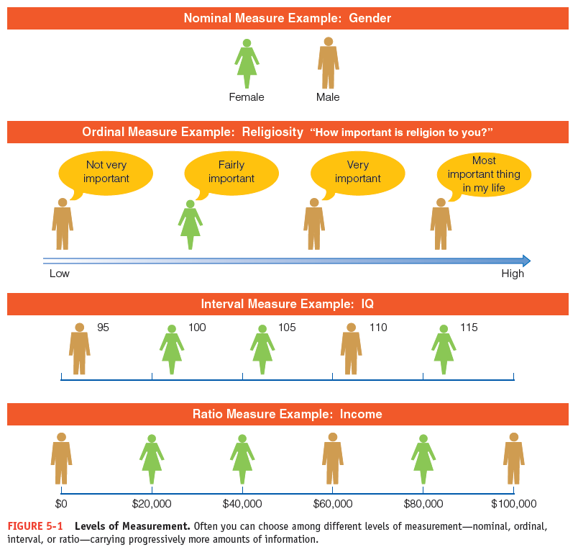
Levels of Measurement

Slide 24
Cumulative Property
Variables measured at interval-ratio level (highest) can also be measured at ordinal or nominal (lower) levels
Variables measured at nominal and ordinal levels can’t be measured at higher levels

Slide 25
Variables
Discrete
Have measurement that cannot be sub-divided. Nominal/Ordinal and Integer Interval level variables
The number of children per family

Slide 26
Variables
Continuous
Variables that can theoretically can take on all possible numerical values in a given interval. Interval level variables
Length

Slide 27
Analyzing Data
Population
The total set of individuals, objects, groups, or events in which the researcher is interested
Sample
A relatively small subset selected from a population

Slide 28
Analyzing Data
Descriptive statistics
Procedures that help us describe data collected from either a sample or a population
Inferential statistics
Procedures concerned with making predictions about a population from analyses of a sample

Slide 29
Key Terms
Independent Variable
Inferential Statistics
Interval-ratio
Measurement
Nominal Measurement
Data
Dependent Variable
Descriptive Statistics
Dichotomous Variable
Empirical Research
Hypothesis

Slide 30
Key Terms
Ordinal Measurement
Population
Research Process
Sample
Statistics
Theory
Unit of Analysis
Variable

